Slide 1
Applied Machine learning
Regent College London
SWE6302

Slide 2
Applied Machine learning
SWE6302

Slide 3

Machine learning
INTRODUCTION TO
CLUSTERING

Slide 4
Module 1 – Introduction TO clustering

Slide 5
Learning objectives
Critically understand how classification is carried out depending on the classifier used
Interpret the classification output and the metrics to evaluate classifiers
Understand the Clustering Techniques

Slide 6
Classification - key concepts
The most common application of supervised machine learning is building classification models
One-class learning: the goal is to predict if a sample belongs to the class
Two-class learning (binary classification): the objective is to find a boundary able to separate the 2 classes
Multi-class learning: the objective is to find the boundaries able to separate the classes

Slide 7
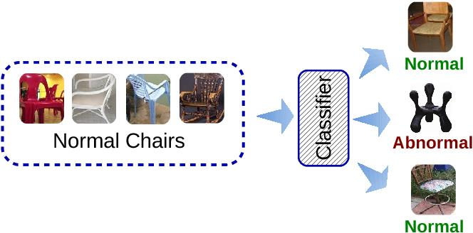
Predict unseen data
How can we make a good prediction of yet unseen data?

Slide 8
Learning algorithm
Machine learning algorithm?
– A machine learning algorithm is an algorithm that is able to learn from experience.
Learning ?
– A computer program is said to learn from experience E with respect to some class of tasks T and performance measure P, if its performance at tasks in T, as measured by P, improves with experience E.
– For every machine learning algorithm, need to define what T, P and E are!

Slide 9
Task : T
The process of learning itself is not the task
Learning is our means of attaining the ability to perform the task
-if we want a robot to be able to walk, then walking is the task
Machine learning tasks are usually described in terms of how the machine learning system should process an example
-An example is a collection of features that have been quantitatively measured from some object or event that we want the machine learning system to process

Slide 10
Task : T
Typically, an example is represented as a vector 𝒙 ∈ Rn where each entry 𝑥𝑖 of the vector is a feature
- The features of an image are the values of the pixels in the image

Slide 11
Task : T
The most common machine learning tasks are:
- Classification: the computer program is asked to specify which of 𝑘 categories some input belongs to.
- Object recognition: pedestrians, cars, buses...
- Regression: the computer program is asked to predict a numerical value given some input
-Prediction of the expected claim amount that an insured person will make (used to set insurance premiums)

Slide 12
Task : T
Transcription: the machine learning system is asked to observe a relatively unstructured representation of some kind of data and transcribe it into discrete, textual form
- Optical character recognition
- Speech recognition (siri etc...)

Slide 13
Task : T
The other most common machine learning tasks are:
Machine translation
Anomaly detection
Synthesis and sampling: the machine learning algorithm is asked to generate new examples that are similar to those in the training data
- Video games can automatically generate textures for large objects or landscapes, rather than requiring an artist to manually label each pixel
Imputation of missing values: the machine learning algorithm is given a new example 𝒙 ∈ R𝑛, but with some entries 𝑥𝑖 of 𝒙 missing
Denoising

Slide 14
Performance measure
In order to evaluate the abilities of a machine learning algorithm, we must design a quantitative measure of its performance
Performance measure P is specific to the task T being carried out by the system
For classification and transcription,
– we often measure the accuracy of the model.
– An equivalent way is to measure the error rate.

Slide 15
Performance measure
Usually we are interested in how well the machine learning algorithm performs on data that it has not seen before.
– Dataset used for training the machine learning system
– Test set used for measuring the performance of the machine learning system

Slide 16
Experience - E
Machine learning algorithms can be broadly categorized as Unsupervised & Supervised
Unsupervised learning algorithms experience a dataset containing many features, then learn useful properties of the structure of this dataset
– The data is unlabelled used in clustering methods for example
– In unsupervised learning, there is no instructor or teacher, the algorithm must learn to make sense of the data without this guide.

Slide 17
Experience - E
Supervised learning algorithms experience a dataset containing features, but each example is also associated with a label or target.
– Classify iris plants into three different species based on their
measurements
– An instructor or teacher shows the machine learning system what to do

Slide 18
Data set
Most machine learning algorithms simply experience a dataset. A dataset can be described in many ways. In all cases, a dataset is a collection of examples, which are in turn collections of features.
One common way of describing a dataset is with a design matrix.
– One sample per row
– One feature per column

Slide 19
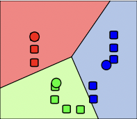
K-means Clustering
Attempts to split data into K groups that are closest to K centroids
Unsupervised learning – uses only the positions of each data point
Can uncover interesting groupings of people / things / behaviour
▫ Example: Where do millionaires live?
▫ What genres of music / movies / etc. naturally fall out of data?
▫ Create your own stereotypes from demographic data

Slide 20
K-means Clustering
Sounds fancy! Wow! Unsupervised machine learning! Clusters! K!
Actually how it works is really simple.
▫ Randomly pick K centroids (k-means)
▫ Assign each data point to the centroid it’s closest to
▫ Recompute the centroids based on the average position of each centroid’s points
▫ Iterate until points stop changing assignment to centroids
If you want to predict the cluster for new points, just find the centroid they’re closest to.

Slide 21
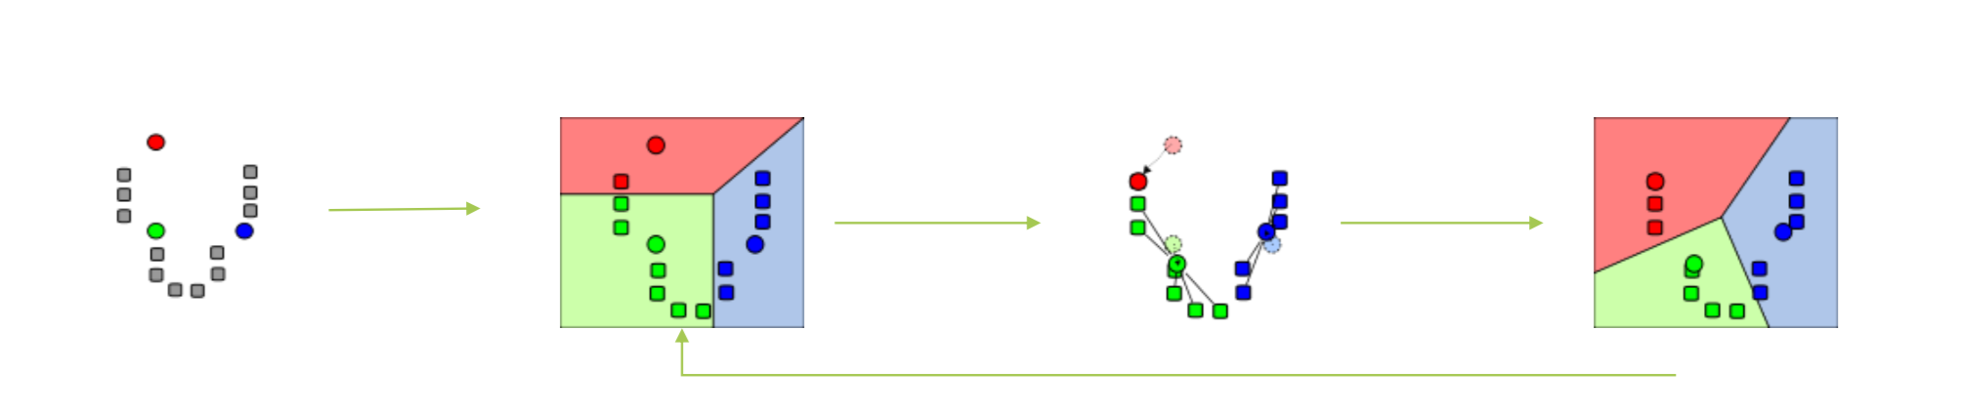
Graphical example

Slide 22
K-means clustering technique
Choosing K
Try increasing K values until you stop getting large reductions in squared error (distances from each point to their centroids)
Avoiding local minima
▫ The random choice of initial centroids can yield different results
▫ Run it a few times just to make sure your initial results aren’t wacky
Labelling the clusters
▫ K-Means does not attempt to assign any meaning to the clusters you find
  ▫ It’s up to you to dig into the data and try to determine that

Slide 23
K- Means clustering tutorial
https://developers.google.com/machine-learning/clustering/clustering-algorithms
https://www.w3schools.com/python/python_ml_k-means.asp
https://www.youtube.com/watch?v=1XqG0kaJVHY
https://www.youtube.com/watch?v=4jv1pUrG0Zk

